Slide 1

Taller Python
Sesión 2

Slide 2
Listas
Python has a powerful built-in list type:
[]
[1]
[1, 2, 3, 4, 5, 6, 7, 8, 12]
[1, "two", 3, 4.0, ["a", "b"], (5,6)]
A list can contain a mixture of other types as its elements, including strings, tuples, lists, dictionaries, functions, file objects, and any type of number
Some built-in functions (len, max, and min), some operators (in, +, and *), the del statement, and the list methods (append, count, extend, index, insert, pop,remove, reverse, and sort) operate on lists:

Slide 3
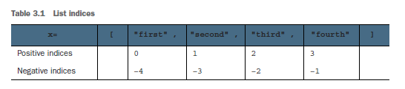
A list can be indexed from its front or back. You can also refer to a subsegment, or slice, of a list by using slice notation
Index from the front B using positive indices (starting with 0 as the first element).
Index from the back c using negative indices (starting with -1 as the last element).
Obtain a slice using [m:n] d, where m is the inclusive starting point and n is the exclusive ending point (see table 3.1). An [:n] slice e starts at its beginning, and an [m:] slice goes to a list’s end.

Slide 4
Tuplas
Tuples are similar to lists but are immutable—that is, they can’t be modified after they’ve been created.
The operators (in, +, and *) and built-in functions (len, max,and min) operate on them the same way as they do on lists because none of them modifies the original.
Index and slice notation work the same way for obtaining elements or slices but can’t be used to add, remove, or replace elements. Also, there are only two tuple methods: count and index. An important purpose of tuples is for use as keys for dictionaries. They’re also more efficient to use when you don’t need modifiability.

Slide 5
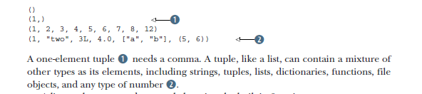

Slide 6

Strings
String processing is one of Python’s strengths. There are many options for delimiting
strings:
The operators and functions that work with them return new strings derived from the original. The operators (in, +, and *) and built-in functions (len, max, and min) operate on strings as they do on lists and tuples. Index and slice notation works the same way for obtaining elements or slices but can’t be used to add, remove, or replace elements.
Strings have several methods to work with their contents, and the re library module
also contains functions for working with strings:

Slide 7
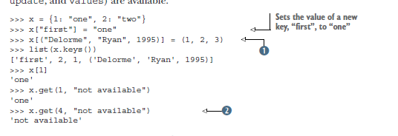
Dictionaries
Python’s built-in dictionary data type provides associative array functionality implemented by using hash tables.
As is the case for lists, several dictionary methods (clear, copy, get, items, keys,update, and values) are available.

Slide 8
Keys must be of an immutable type B, including numbers, strings, and tuples. Values can be any kind of object, including mutable types such as lists and dictionaries. If you try to access the value of a key that isn’t in the dictionary, a Key Error exception is aised. To avoid this error, the dictionary method get c optionally returns a user definable value when a key isn’t in a dictionary

Slide 9
Sets
A set in Python is an unordered collection of objects, used in situations where membership and uniqueness in the set are the main things you need to know about that object. Sets behave as collections of dictionary keys without any associated values:

Slide 10

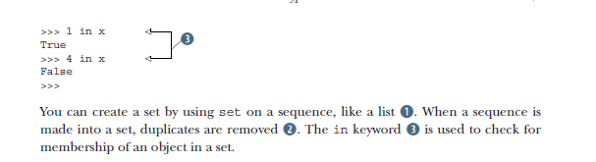

Slide 11
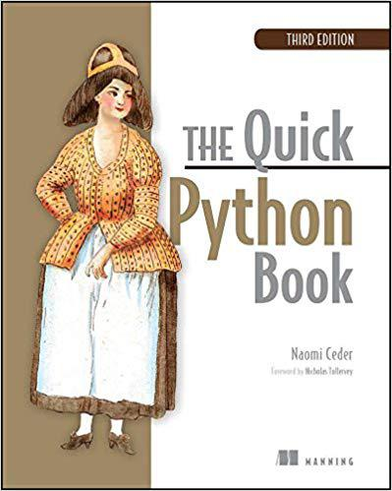
Referencias
Naomi Ceder : The Quick Python Book, Third Edition.

Slide 12
